Slide 1
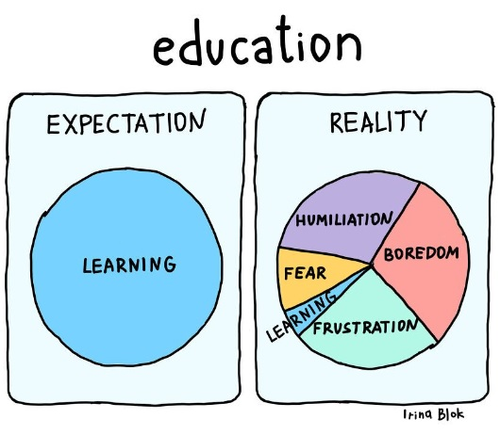
Notes:
Source: https://www.linkedin.com/posts/vijaysangam_education-boredom-frustraion-activity-7140089968583966720-gshG

Slide 2
Module 03: Exploratory Data Analysis – One Categorical Variable

Slide 3
Categorical Variable - Refresher
2 types of variables: categorical variable vs. numerical variable
The method most people use to differentiate them: when responses are numbers, numerical variable; when responses are not numbers, categorical variable.
We will, of course, see some exceptions!
In this course, you will see three sub-classifications:
1) binary data – responses can only have two complementary classes like 0 vs. 1, or Yes vs. No, or even Male vs Female etc.
2) nominal data – responses have all sorts of names, no caps on # of classes
3) ordinal data – (non-numeric) responses can be arranged in orders.

Slide 4
Exploratory Data Analysis or EDA
Exploratory Data Analysis: used primarily in Data Science field
Data Summary: used in Statistics field
EDA or data summary has two key parts: use Graphs and Statistics to understand the data set.
Once the data is cleaned, typically one-third of the time is spent in EDA.
EDA is an art!
And you cannot do well here if you don’t the first C we talked about.

Slide 5

Notes:
Source: https://www.linkedin.com/posts/fabrizioperrone_the-perks-of-being-a-founder-activity-7231848540346486784--9cJ

Slide 6

Categorical Variable - Graphs
2 basic graphs: Pie Charts and Bar Graphs
There are many variations of them.
Pie Charts: look like a circle (or pie), # of slices = # of classes, size (or angle) of the slice represents the “share”.
Bar Graphs: have bars (or columns), # of bars = # of classes, height of the bar represents the “share”.
There are two kinds of common bar graphs – vertical bar (named Column Graphs in some software) or horizontal bar.
I personally prefer vertical bar graphs with the variable of interest is on the x-axis.
Notes:
Source: https://www.youtube.com/watch?v=f_J8QU1m0Ng&t=11s

Slide 7
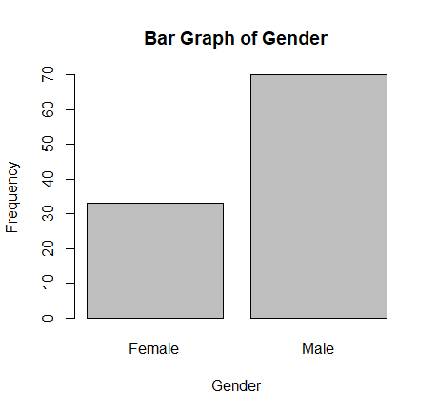
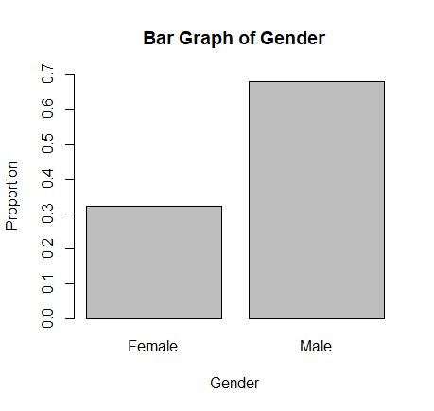
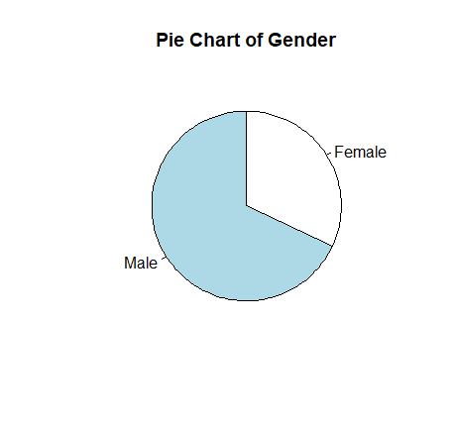
Graphs Example 1 – Gender
Data source: from my former STAT 4800 students, with n = 103 students
Variable and type: Gender, categorical variable, binary data
Which one is better?
Notes:
Use base R functions: pie() and barplot()

Slide 8
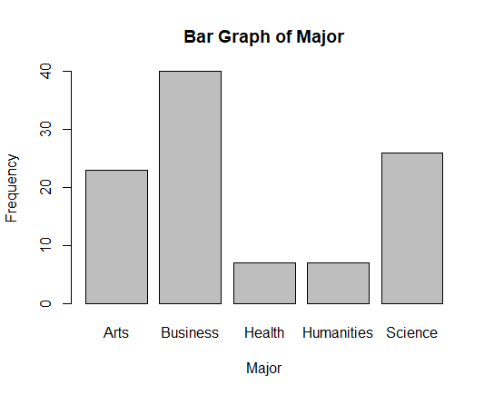
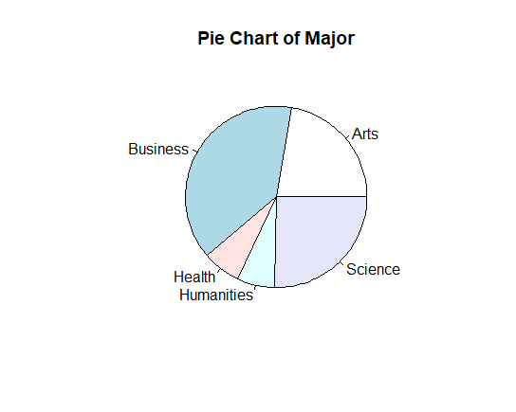
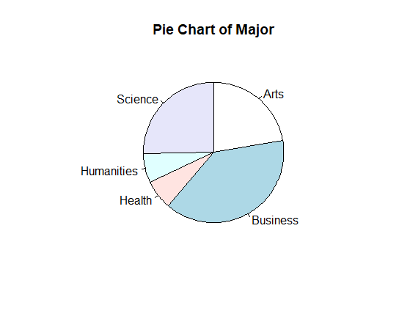
Graphs Example 2 – Major
Variable and type: Major, categorical variable, nominal data
Which one is better?

Slide 9
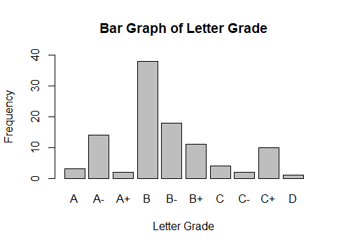
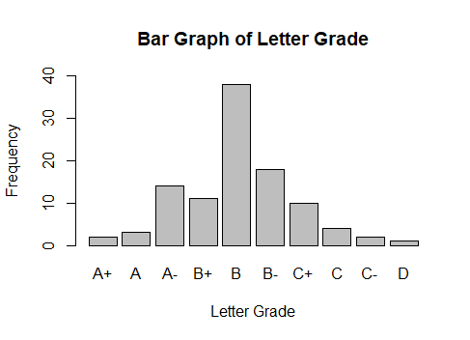
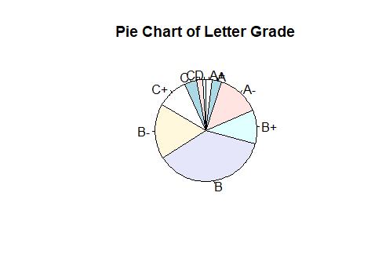
Graphs Example 3 – Grades
Variable and type: Grades, categorical variable, ordinal data
Which one is better?

Slide 10
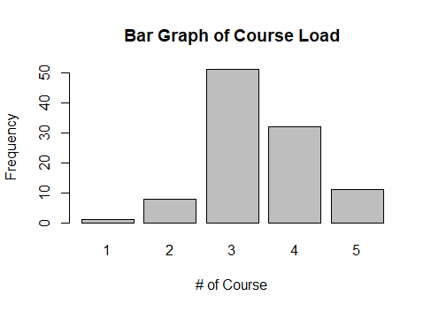

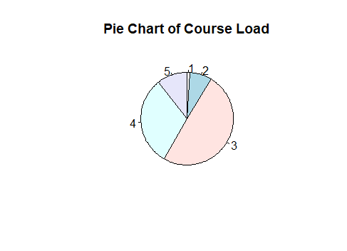
Graphs Example 4 – Course (Load)
Variable and type: Course Load, categorical variable, ordinal data
Which one is better?
Q: Should we even use bar graph or pie chart here?
Q: Is the data numeric or non-numeric?

Slide 11

My Takeaway: Numbers Are Good, Visualization Is Better, Storytelling Is Best!
Notes:
URL: https://www.youtube.com/watch?v=jbkSRLYSojo
Duration: 4m48s

Slide 12
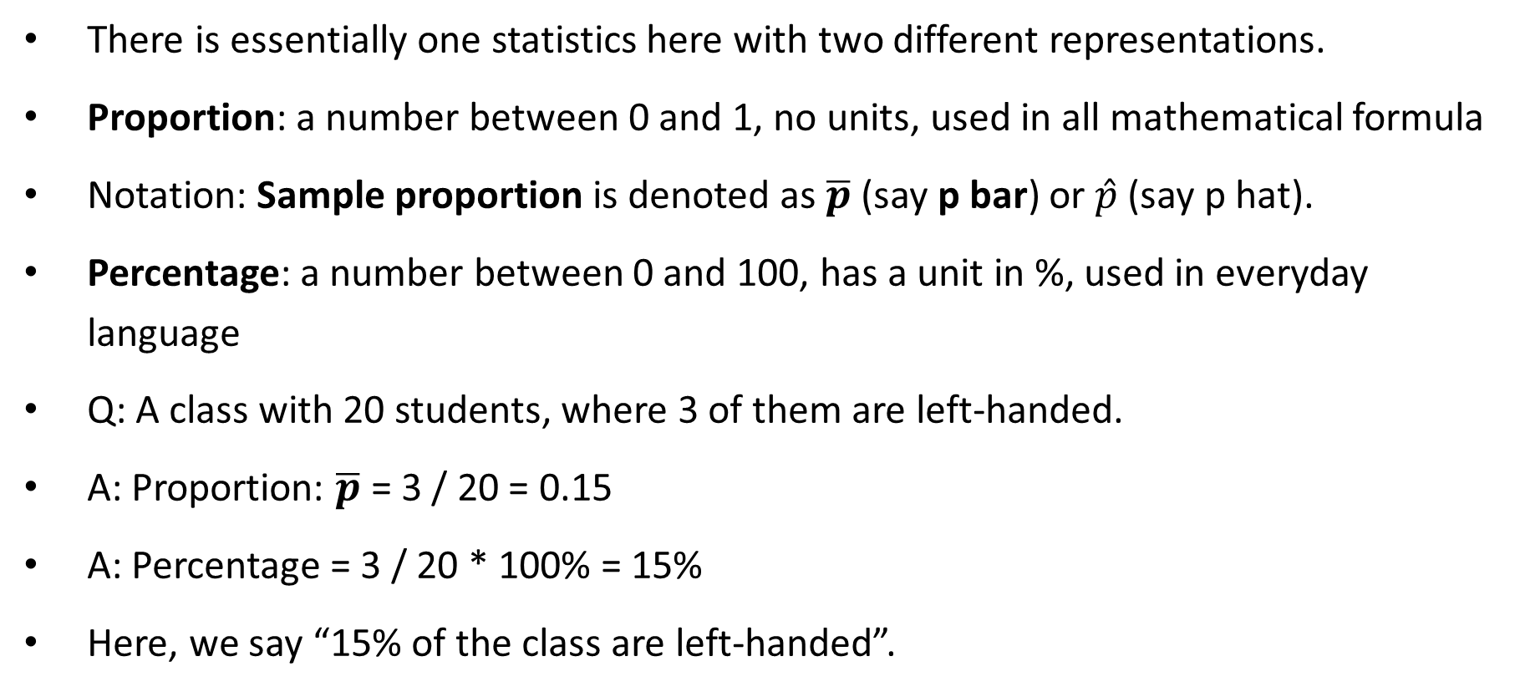
Categorical Variable – Statistics Calculation
There is essentially one statistics here with two different representations.
Proportion: a number between 0 and 1, no units, used in all mathematical formula
Notation: Sample proportion is denoted as $\overline{p}$ (say p bar) or $\hat{p}$ (say p hat).
Percentage: a number between 0 and 100, has a unit in %, used in everyday language
Q: A class with 20 students, where 3 of them are left-handed.
A: Proportion: $\overline{p}$ = 3 / 20 = 0.15
A: Percentage = 3 / 20 * 100% = 15%
Here, we say “15% of the class are left-handed”.

Slide 13
Description of Statistics
The third C is about how we share information with others, in a certain way.
A statistic is defined as 1) a single (summarized) value of 2) the variable of interest from 3) a sample.
Example: Suppose we want to know if British Columbians would vote for the BC NDP in the upcoming provincial election. A random sample of 500 BC-ians is drawn. Provide a description of the statistic.
Statistic = the percentage of 500 randomly selected BC-ians who would vote for the BC NDP.
Or it could also be “the proportion of 500 randomly selected BC-ians who would vote for the BC NDP”.

Slide 14
Description of Parameters
A parameter is defined similarly as 1) a single (summarized) value of 2) the variable of interest from 3) the (target) population.
Mnemonic: Statistic is from Sample, Parameter is from Population
Example: Suppose we want to know if British Columbians would vote for the BC NDP in the upcoming provincial election. A random sample of 500 BC-ians is drawn. Provide a description of the parameter.
Parameter = the percentage of all BC-ians who would vote for the BC NDP.
(Compare with…) statistic = the percentage of 500 randomly selected BC-ians who would vote for the BC NDP.
How sampling error was defined again?

Slide 15

Any Questions?

